Slide 1
Chapter 3
Retailing in Electronic Commerce: Products and Services

Slide 2
Learning Objectives
Describe electronic retailing (e-tailing) and its characteristics.
Define and describe the primary e-tailing business models.
Describe how online travel and tourism services operate and their impact on the industry.
Discuss the online employment market, including its participants, benefits, and limitations.
Describe online real estate services.
Discuss online stock-trading services.

Slide 3
Learning Objectives
Discuss cyberbanking and online personal finance.
Describe on-demand delivery by e-grocers.
Describe the delivery of digital products and online entertainment.
Discuss various e-tail consumer aids, including comparison-shopping aids.
Identify the critical success factors and failure avoidance tactics for direct online marketing and
e-tailing.
Describe reintermediation, channel conflict, and personalization in e-tailing.

Slide 4
Internet Marketing and Electronic Retailing
electronic retailing (e-tailing)
Retailing conducted online, over the Internet
e-tailers
Retailers who sell over the Internet

Slide 5
Internet Marketing and Electronic Retailing
What Sells Well on the Internet?
Travel
Computer Hardware and Software
Consumer Electronics
Office Supplies
Sport and Fitness Goods
Books and Music
Toys
Health and Beauty
Entertainment
Apparel and Clothing
Jewelry
Cars
Services
Pet Supplies

Slide 6
Internet Marketing and Electronic Retailing
Characteristics of Successful
E-Tailing
  High brand recognition
  A guarantee provided by highly reliable or well-known vendors
  Digitized format
  Relatively inexpensive items
  Frequently purchased items
  Commodities with standard specifications
  Well-known packaged items that cannot be opened even in a traditional store

Slide 7
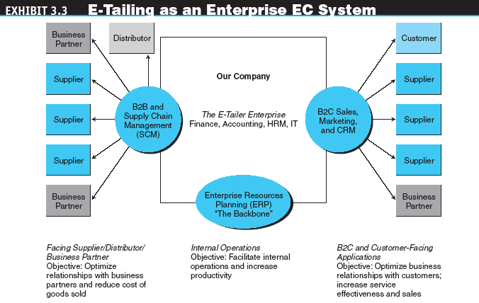
E-Tailing Business Models

Slide 8
E-Tailing Business Models
Classification by Distribution Channel
  Mail-order retailers that go online
  Direct marketing from manufacturers
  Pure-play e-tailers
  Click-and-mortar retailers
  Internet (online) malls

Slide 9
E-Tailing Business Models
direct marketing
Broadly, marketing that takes place without intermediaries between manufacturers and buyers; in the context of this book, marketing done online between any seller and buyer
virtual (pure-play) e-tailers
Firms that sell directly to consumers over the Internet without maintaining a physical sales channel

Slide 10
E-Tailing Business Models
click-and-mortar retailers
Brick-and-mortar retailers that offer a transactional Web site from which to conduct business
brick-and-mortar retailers
Retailers who do business in the non-Internet, physical world in traditional brick-and-mortar stores

Slide 11
E-Tailing Business Models
multichannel business model
A business model where a company sells in multiple marketing channels simultaneously (e.g., both physical and online stores)
Retailing in Online Malls
  Referring directories
  Malls with shared services

Slide 12
E-Tailing Business Models
Other B2C Models and Special Retailing
  Representative special B2C services
    Postal services
    Services and products for adults
    Wedding channels
    Gift registries

Slide 13
Travel and Tourism Services Online
Special Services
  Wireless services
  Direct marketing
  Alliances and consortia

Slide 14
Travel and Tourism Services Online
Benefits of Online Travel Services
  To travelers
    Free information accessible at any time from any place
    Substantial discounts are available
  To travel services providers
    Airlines, hotels, and cruise lines sell otherwise-empty spaces
    Direct selling saves the provider’s commission and its processing

Slide 15
Travel and Tourism Services Online
Limitations of Online Travel Services
  Many people do not use the Internet
  The amount of time and the difficulty of using virtual travel agencies may be significant, especially for complex trips and for inexperienced Internet surfers
  Complex trips or those that require stopovers may not be available online because they require specialized knowledge and arrangements

Slide 16
Travel and Tourism Services Online
Corporate Travel
  To reduce corporate travel costs, companies can make arrangements that enable employees to plan and book their own trips
Impact of EC on the Travel Industry
  The Internet may be contributing to a sharp reduction in the number of travel agents
  It has also driven the rise of intermediaries—third-party online sellers and portals provide price comparisons and a range of other value-adding services for the consumer

Slide 17
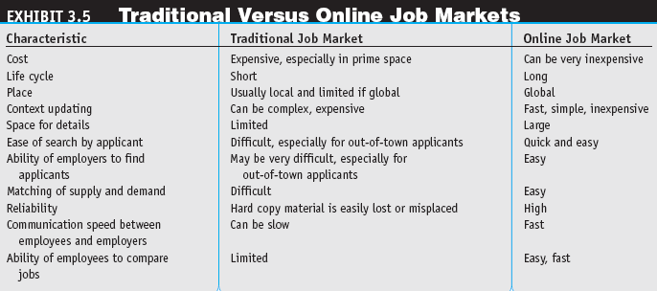
Employment, Placement, and the Job Market Online

Slide 18
Employment, Placement, and the Job Market Online
THE INTERNET JOB MARKET
  Job seekers
  Employers seeking employees
  Job agencies
  Government agencies and institutions
A consortium of large employers and college careers advisors
Global online portals

Slide 19
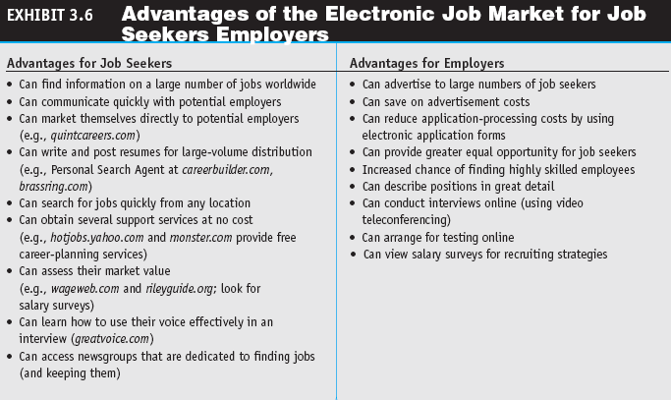
Employment, Placement, and the Job Market Online

Slide 20
Employment, Placement, and the Job Market Online
Limitations of the Electronic Job Market
  The gap between those with skills and access to the Internet and those without
  Companies find that they are flooded with applicants when they advertise online, screening is a time-consuming and costly process
  Security and privacy
  High turnover costs for employers by accelerating employees’ movement to better jobs

Slide 21
Employment, Placement, and the Job Market Online
Intelligent Agents in the Electronic Job Market
  Intelligent agents for job seekers
  Intelligent agents for employers

Slide 22
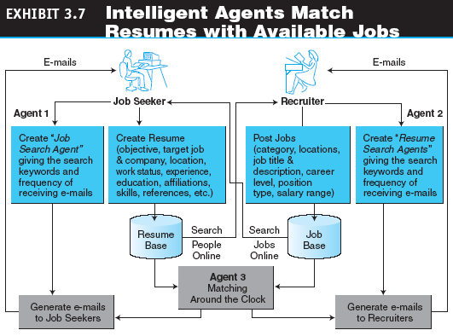
Employment, Placement, and the Job Market Online

Slide 23
Real Estate, Insurance, and Stock Trading Online
Real Estate
  E-commerce and the Internet are slowly but surely having an ever increasing impact on the real estate industry
Real Estate Applications
  Advice for consumers on buying or selling
  Commercial real estate listings
  Links to house listings in all major cities
  Maps
  Information on current mortgage rates

Slide 24
Real Estate, Insurance, and Stock Trading Online
  Real Estate Mortgages
    Many sites offer loan calculators
    Mortgage brokers can pass loan applications over the Internet and receive bids from lenders that want to issue mortgages
    “Name your own price” model
    Aggregation of loan seekers package placed for bid on the Internet

Slide 25
Real Estate, Insurance, and Stock Trading Online
Insurance Online
  Standard insurance policies, such as auto, home, life, or health are offered at a substantial discount
  Third-party aggregators offer free comparisons of available policies
  Several large insurance and risk-management companies offer comprehensive insurance contracts online

Slide 26
Real Estate, Insurance, and Stock Trading Online
Online Stock Trading
  Investment information
  Related financial markets
  The risk of having an online stock account

Slide 27
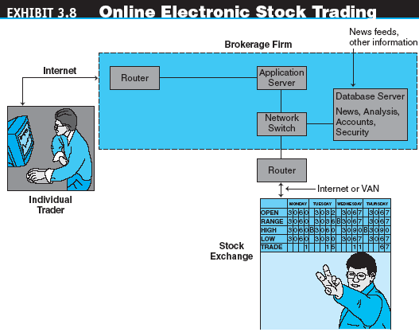
Real Estate, Insurance, and Stock Trading Online

Slide 28
Banking and
Personal Finance Online
electronic (online) banking (e-banking)
Various banking activities conducted from home or the road using an Internet connection; also known as cyberbanking, virtual banking, online banking, and home banking

Slide 29
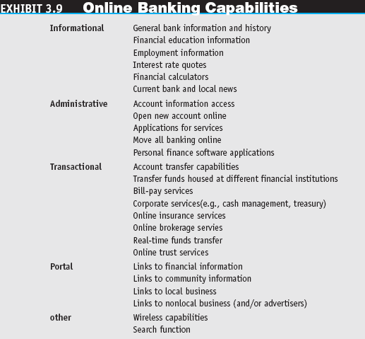
Banking and
Personal Finance Online

Slide 30
Banking and
Personal Finance Online
International and Multiple-Currency Banking
  Some international retail purchasing can be done by providing a credit card number, other transactions may require international banking support

Slide 31
Banking and
Personal Finance Online
Online Financial Transaction Implementation Issues
  Securing financial transactions
  Access to banks’ intranets by outsiders
  Imaging systems
  Pricing online versus offline services
  Risks

Slide 32
Banking and
Personal Finance Online
Personal Finance Online
  Online Billing and Bill Paying
    Automatic transfer of mortgage payments
    Automatic transfer of funds to pay monthly utility bills
    Paying bills from online banking accounts.
    Merchant-to-customer direct billing
    Using an intermediary for bill consolidation
    Person-to-person direct payment
    Pay bills at bank kiosks
  Taxes

Slide 33
On-Demand Delivery Systems and E-Grocers
e-grocer
A grocer that takes orders online and provides deliveries on a daily or other regular schedule or within a very short period of time
on-demand delivery service
Express delivery made fairly quickly after an online order is received

Slide 34
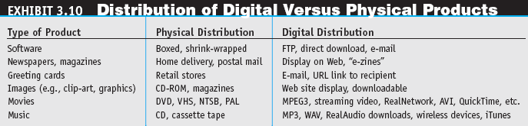
Online Delivery of Digital Products, Entertainment, and Media

Slide 35
Online Delivery of Digital Products, Entertainment, and Media
Online Entertainment
  Examples of online entertainment
    Web browsing
    Internet gaming
    Fantasy sports games
    Single and multiplayer games
    Adult entertainment
    Card games
    Social networking sites
    Participatory Web sites
    Reading
    Live events

Slide 36
Online Delivery of Digital Products, Entertainment, and Media
  Entertainment-related services
    Event ticketing
    Restaurants
    Information retrieval
    Retrieval of audio and video entertainment

Slide 37
Online Delivery of Digital Products, Entertainment, and Media
Developments in the Delivery of Digital Products
  CD customization sites
  The disintermediation of traditional print media
  Digital delivery may replace or enhance traditional delivery methods for various types of digital content

Slide 38
Online Purchase-Decision Aids
shopping portals
Gateways to e-storefronts and e-malls; may be comprehensive or niche oriented
shopping robots (shopping agents or shopbots)
Tools that scout the Web on behalf of consumers who specify search criteria
  “Spy” services
  Wireless Shopping comparisons

Slide 39
Online Purchase-Decision Aids
Business Ratings Sites
Trust Verification Sites
Other Shopping Tools
  Amazon.com’s A9 Search Engine
  Answers.com

Slide 40
Problems with E-Tailing and Lessons Learned
The reasons that retailers give for not going online include:
  Their product is not appropriate for Web sales
  Lack of significant opportunity
  High cost
  Technological immaturity
  Online sales conflict with core business

Slide 41
Problems with E-Tailing and Lessons Learned
Lessons Learned
  Don’t ignore profitability
  Manage new risk exposure
  Watch the cost of branding
  Do not start with insufficient funds
  The web site must be effective
  Keep it interesting

Slide 42
Problems with E-Tailing and Lessons Learned
Successful Click-and-Mortar Strategies
  Speak with one voice
  Leverage the multichannels
  Empower the customer

Slide 43
Issues in E-Tailing
disintermediation
The removal of organizations or business process layers responsible for certain intermediary steps in a given supply chain
reintermediation
The process whereby intermediaries (either new ones or those that had been disintermediated) take on new intermediary roles

Slide 44
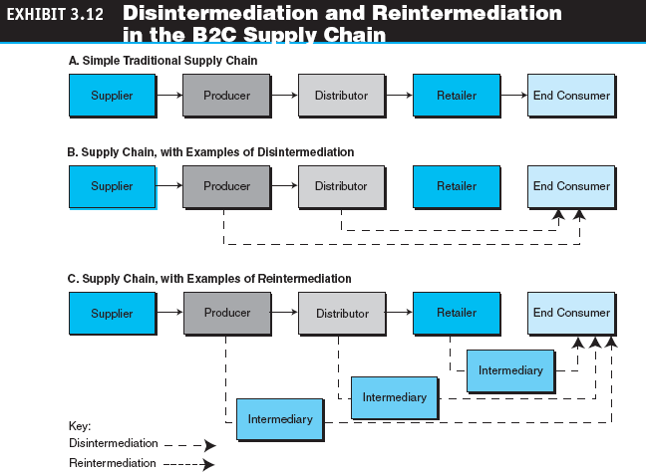
Issues in E-Tailing

Slide 45
Issues in E-Tailing
cybermediation (electronic intermediation)
The use of software (intelligent) agents to facilitate intermediation
hypermediation
Extensive use of both human and electronic intermediation to provide assistance in all phases of an e-commerce venture
Unbundling

Slide 46
Issues in E-Tailing
channel conflict
Situation in which an online marketing channel upsets the traditional channels due to real or perceived damage from competition

Slide 47
Issues in E-Tailing
Determining the Right Price
Personalization
Fraud and Other Illegal Activities
How to Make Customers Happy

Slide 48
Managerial Issues
What should our strategic position be?
Are we financially viable?
How should we introduce wireless shopping?
Are there international legal issues regarding online recruiting?

Slide 49
Managerial Issues
Do we have ethics and privacy guidelines?
How will intermediaries act in cyberspace?
Should we set up alliances?

